Slide 1
Linear Algebra and Quantum Physics
Learn Basic Quantum Physics in the point of view of Linear Algebra
不正经讲师：理科宅Hunt

Slide 2
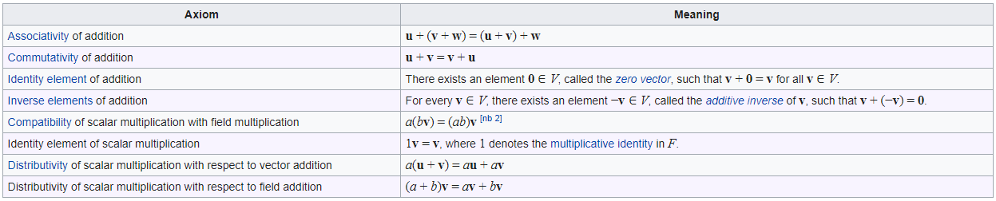
Abstract vector space
A set is called vector space (矢量空间) if it satisfies the following axioms. The elements in the set are called vectors (矢量).

Slide 3

Example – All complex functions
Let $H$ be a set of complex functions defined on $ℂ$. Then $H$ is an abstract vector space.
Let $f,g,h∈H$, and $a,b∈ℂ$ then
$f+\left(g+h\right)=\left(f+g\right)+h$
$f+g=g+f$
…
$a\left(f+g\right)=af+bg$
$\left(a+b\right)f=af+bf$
A set of all wave functions (波函数) is vector space. We can treat wave functions as vectors!

Slide 4

Example – Electron spins(电子自旋)
Let $H$ be a set of wave functions that describes electron spin in $z$-direction. Then $H$ is an abstract vector space.
$$H=\left\{Spin up, Spin down\right\}$$
Using Dirac notation, we can denote them as
$$\left|0\right\rangle =Spin up, \left|1\right\rangle =Spin down$$
$|0⟩$ and $|1⟩$ are called “qubit”(量子比特).

Slide 5

Example – Photon polarizations (光的偏振)
Let $H$ be a set of polarizations of light. Then $H$ is an abstract vector space.
$$H=\left\{Horizontal, Vertical\right\}$$
Using Dirac notation, we can denote them as
$$\left|0\right\rangle =Horizontal, \left|1\right\rangle =Vertical$$
$|0⟩$ and $|1⟩$ are called “qubit”.

Slide 6

Inner product and Hilbert space
Define inner product (内积) of complex functions, $|ψ⟩$ and $|φ⟩$ as
$$\left\langle φ | ψ\right\rangle =\int_{−∞}^{∞}{\overline{φ} (x)ψ(x)dx} (if ψ and φ are functions)$$
$$\left\langle φ | ψ\right\rangle =φ^{† }ψ={\overline{φ}}^{T}ψ (if φ and ψ are column vectors)$$
Simply speak: Hilbert space (希尔伯特空间) is a complex vector space with inner product.
$\left\langle ⋅\right|$ are called bra-vector and $\left|⋅\right\rangle$ are called ket-vector. Together $\left\langle ⋅ | ⋅\right\rangle$, it’s called bracket :D

Slide 7

Physical interpretation of inner product
Suppose $|ψ⟩$ is the initial state of a particle, then the probability of finding it in $|φ⟩$ state is given by
$${\left|\left\langle φ | ψ\right\rangle \right|}^{2}$$

Slide 8

Properties of qubits
The qubits are normalized (归一的),
$$\left\langle 0 | 0\right\rangle =1, \left\langle 1 | 1\right\rangle =1$$
The qubits are orthogonal (正交的),
$$\left\langle 0 | 1\right\rangle =0,\left\langle 1 | 0\right\rangle =0$$
Therefore, qubits form a basis of their Hilbert space. i.e. Any quantum states can be represented using linear combination of $\left|0\right\rangle$ and $|1⟩$.
Sometimes, it is more convenient to write them as
$$\left\langle i | j\right\rangle =δ_{ij}$$
Where $δ_{ij}$ is Kronecker delta,
$$δ_{ij}=\left\{\begin{aligned}0, i≠j \\ &1, i=j\end{aligned}\right.$$

Slide 9
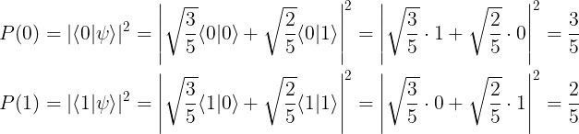

Superposition of states (叠加态)
Suppose an electron’s spin can be described by a wave function
$$\left|ψ\right\rangle =\sqrt{\frac{3}{5}}\left|0\right\rangle +\sqrt{\frac{2}{5}}|1⟩$$
Find the probability of measuring $|0⟩$ state and $|1⟩$ state.
Solution:

Slide 10
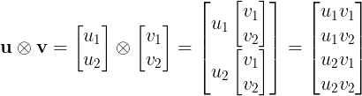
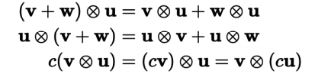

Tensor product (张量积)
Tensor product between 2 vectors is defined as
In quantum physics, we have several notations for tensor product
$$\left|ψ\right\rangle ⊗\left|φ\right\rangle ≡\left|ψ\right\rangle \left|φ\right\rangle ≡\left|ψ,φ\right\rangle ≡\left|ψφ\right\rangle$$
Tensor product has the following properties:
Tensor product is not commutative, ORDER IS IMPORTANT!

Slide 11

Inner product on the tensor products
Suppose $|ψ_{1}⟩,|φ_{1}⟩∈H_{1}$ and $|ψ_{2}⟩,|φ_{2}⟩∈H_{2}$ where $H_{1}$ and $H_{2}$ are two Hilbert spaces. Then
$$\left\langle φ_{1}φ_{2} | ψ_{1}ψ_{2}\right\rangle ={\left\langle φ_{1} | ψ_{1}\right\rangle }_{1}{\left\langle φ_{2} | ψ_{2}\right\rangle }_{2}$$
Where ${\left\langle ⋅ | ⋅\right\rangle }_{1}$ and ${\left\langle ⋅ | ⋅\right\rangle }_{2}$ are inner product defined on $H_{1}$ and $H_{2}$, respectively.
Example:
$$\left\langle 01 | 01\right\rangle =\left\langle 0 | 0\right\rangle \left\langle 1 | 1\right\rangle =1⋅1=1$$
$$\left\langle 011 | 010\right\rangle =\left\langle 0 | 0\right\rangle \left\langle 1 | 1\right\rangle \left\langle 1 | 0\right\rangle =1⋅1⋅0=0$$
Two quantum states are orthogonal if qubits are different.

Slide 12
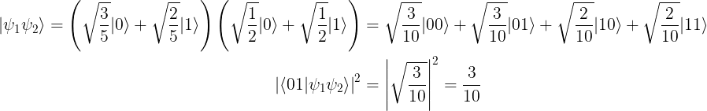

Example
Suppose there are 2 electrons, their spins are
$$\left|ψ_{1}\right\rangle =\sqrt{\frac{3}{5}}\left|0\right\rangle +\sqrt{\frac{2}{5}}\left|1\right\rangle , \left|ψ_{2}\right\rangle =\sqrt{\frac{1}{2}}\left|0\right\rangle +\sqrt{\frac{1}{2}}|1⟩$$
Find the probability of measuring electron 1 in $|0⟩$ state and electron 2 in $|1⟩$ state (in state $|01⟩$).
Solution:

Slide 13

Outer product (外积)
The outer product of two vectors $|ψ⟩$ and $|φ⟩$ are defined as
$$|ψ⟩⟨φ|=\left|ψ\right\rangle ⊗⟨φ|$$
Outer product is used to produce operators (算符).
Example: Let $\left|ψ\right\rangle =\sqrt{\frac{1}{2}}\left|0\right\rangle +\sqrt{\frac{1}{2}}|1⟩$. Then ${\hat{P}}_{0}≡|0⟩⟨0|$ is a projection operator (投影算符) and it projects the wave function onto $|0⟩$ state.
$${\hat{P}}_{0}\left|ψ\right\rangle =\sqrt{\frac{1}{2}}\left|0\right\rangle \left\langle 0 | 0\right\rangle +\sqrt{\frac{1}{2}}\left|0\right\rangle \left\langle 0 | 1\right\rangle =\sqrt{\frac{1}{2}}\left|0\right\rangle$$

Slide 14

Eigenvalues and Eigenvectors
Let $\hat{A}$ be an operator. If
$$\hat{A}\left|ψ\right\rangle =λ|ψ⟩$$
Then $λ$ is an eigenvalue (特征值) of $\hat{A}$ and $|ψ⟩$ is an eigenvector (特征向量) associated with $λ$.
Example: Find the eigenvalues and eigenvectors of projection operator
$$\hat{P}≡|0⟩⟨0|$$
Solution: Eigenvalues are 1 and 0, eigenvectors are $|0⟩$and $|1⟩$.
$$\hat{P}\left|0\right\rangle =1⋅|0⟩$$
$$\hat{P}\left|1\right\rangle =0⋅|1⟩$$

Slide 15
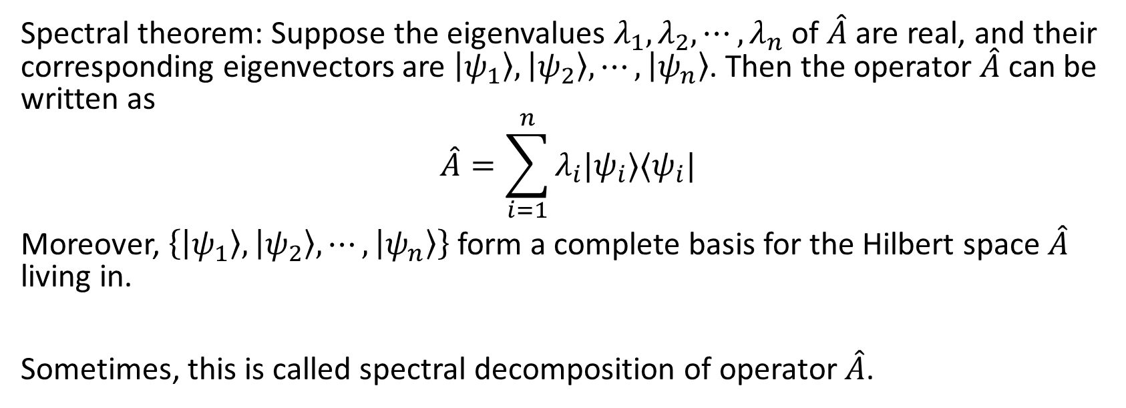
Spectral theorem (谱定理)
Spectral theorem: Suppose the eigenvalues $λ_{1},λ_{2},⋯,λ_{n}$ of $\hat{A}$ are real, and their corresponding eigenvectors are $\left|ψ_{1}\right\rangle ,\left|ψ_{2}\right\rangle ,⋯,\left|ψ_{n}\right\rangle$. Then the operator $\hat{A}$ can be written as
$$\hat{A}=\sum_{i=1}^{n}{λ_{i}|ψ_{i}⟩⟨ψ_{i}|}$$
Moreover, $\left\{\left|ψ_{1}\right\rangle ,\left|ψ_{2}\right\rangle ,⋯,\left|ψ_{n}\right\rangle \right\}$ form a complete basis for the Hilbert space $\hat{A}$ living in.
Sometimes, this is called spectral decomposition of operator $\hat{A}$.

Slide 16

Completeness relation (完备性关系)
From spectral theorem, we can easily get the so-called completeness relation:
$\left\{\left|ψ_{1}\right\rangle ,\left|ψ_{2}\right\rangle ,⋯,\left|ψ_{n}\right\rangle \right\}$ is a complete basis if and only if
$$I=\sum_{i=1}^{n}{|ψ_{i}⟩⟨ψ_{i}|}$$
Where $I$ is an identity matrix.

Slide 17
Summary
Abstract vector space
Inner product
Superposition
Tensor product
Multiple qubits
Outer product
Projection operator
Eigenvalues and Eigenvectors
Spectral theorem
Completeness relation

